Slide 1
Outline of Today’s Discussion
Those Pesky Partials
Seeing the not-quite-so-big picture Parsimony: Is it worth it?
The Collinearity Problem

Slide 2
Part 1
Those Pesky Partials

Slide 3
Those Pesky Partials
Why do we use partialing?
to hold constant, adjust for, or control for one or more variables
In other words…partials eliminate confounds!
Often used by researchers to sort out alternative explanations for relations among variables

Slide 4
Those Pesky Partials
Let’s consider the 3 types of r-squared…
r²
Partial r²
Semi-partial r²

Slide 5
Zero-order correlation = bivariate correlation
r² is the proportion of the total criterion-variance explained by this predictor.

Slide 6
Those Pesky Partials
Partial Correlation ‘controls for’ the influence of other predictors!
Partial r²
Night
Crednow
The shared variability between one predictor (night) and the
other predictors is removed from both the predictor and the criterion.
Notice that ‘chunks’ are removed from predictor AND criterion.

Slide 7
Those Pesky Partials
Semi-Partial Correlation ‘controls for’ the influence of other predictors!
So, it’s similar to the partial correlation in that way.
Semi-Partial r²
Night
Crednow
The shared variability between one predictor (night) and the
other predictors is removed from the predictor only. (Not the criterion!!)
Notice that a ‘chunk’ is removed from predictor only.

Slide 8
Those Pesky Partials
r² = proportion of variance shared by the criterion and this predictor.
Partial r² = UNIQUE contribution of this predictor to the REMAINING UNEXPLAINED variability in the criterion.
Semi-partial r² = UNIQUE contribution of this predictor to the TOTAL variability in the criterion.

Slide 9
Those Pesky Partials
Consider the questions that each type of partial answers…
Partial r² = “If you de-coupled the other predictors from the criterion and from this predictor, what proportion of the remaining criterion-variance would this predictor explain?”
Semi-partial r² = “If you de-coupled this predictor from the other predictors, what proportion of the total criterion-variance would this predictor explain?”

Slide 10
Those Pesky Partials
Zero-order
Partial
Semi-partial
Critical Thinking Questions:
How are zero-order r² and partial r² similar?
How are they and different?

Slide 11
Those Pesky Partials
Zero-order
Partial
Semi-partial
Critical Thinking Questions:
How are partial r² and semi-partial r² similar?
How are they and different?

Slide 12
Those Pesky Partials
Zero-order
Partial
Semi-partial
Critical Thinking Questions:
How are zero-order r² and semi-partial r² similar?
How are they and different?

Slide 13
Part 2
Seeing the Not-Quite-So-Big Picture:
Parsimony – Is It Worth It?

Slide 14
Parsimony – “Is it worth it?”
We can compare the two models in several ways.
First, we might consider the models within the context of “Ockham’s Razor”…
In other words, how much variance does each model explain ‘per unit complexity’?
That is, fewer variables w/b better ALL OTHER THINGS BEING EQUAL.

Slide 15
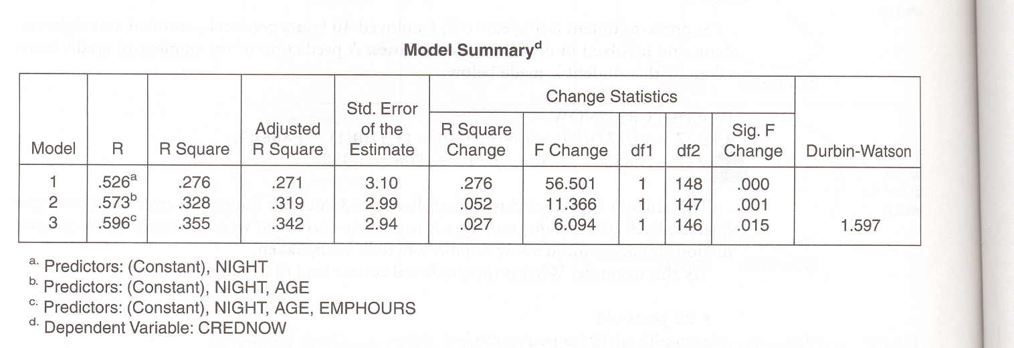
Parsimony – “Is it worth it?”
In the “Big Picture”…the hierarchical model ‘wins’…it offers a better prediction!
Stepwise
MR
Model
35.5% of variance explained
Hierarchical
MR
Model
36.7% of variance explained

Slide 16
Parsimony – “Is it worth it?”
But the hierarchical model also uses 4 variables, not 3. Is it worth it?
Stepwise
MR
Model
35.5% of variance explained
Hierarchical
MR
Model
36.7% of variance explained

Slide 17
Parsimony – “Is it worth it?”
But the hierarchical model also uses 4 variables, not 3. Is it worth it?
Here are the ‘competing’ Raw Score Regression Models
Stepwise (r² = 0.355) with 3 variables
Raw Score: CredNow = 15.175 – 3.42(night) - .087(age) - .0473(emphours)
Hierarchical (r² = 0.367) with 4 variables
Raw Score: CredNow = 15.227 – 3.31(night) - .0078(age) - .0473(emphours) - .806(othact)

Slide 18
Parsimony – “Is it worth it?”
But the hierarchical model also uses 4 variables, not 3. Is it worth it?
Here are the ‘competing’ Z-Score Regression Models
Stepwise (r² = 0.355) with 3 variables
Z-Score: ZCredNow = 0 – .374(Z_{night}) - .205(Z_{age}) - .186(Z_{emphours})
Hierarchical (r² = 0.367) with 4 variables
Z-Score: Z_{CredNow} = 0 – .362(Z_{night}) - .183(Z_{age}) - .186(Z_{emphours}) - .111(Z_{othact})

Slide 19
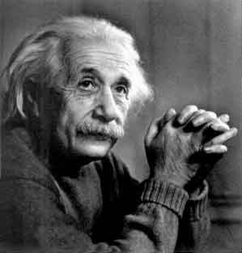
Parsimony – “Is it worth it?”
But the hierarchical model also uses 4 variables, not 3. Is it worth it?
Elegance
is for
tailors!
Some scientists care about parsimony,
but some do NOT!
They want the best model, regardless of the practical cost!

Slide 20
Parsimony – “Is it worth it?”
But the hierarchical model also uses 4 variables, not 3. Is it worth it?
You’re not
explaining much
variance…
You’re Fired!!
Other people are more practical.
They’re careful about how time & money are spent on prediction.

Slide 21
Part 3
The Collinearity Problem

Slide 22
The Collinearity Problem
Why does a jury consist of more than one juror?

Slide 23
The Collinearity Problem
Why is it that husbands and wives are NOT suppose to serve on the same jury?

Slide 24
The Collinearity Problem
Why are jurors not supposed to read or watch media reports
about the trial?

Slide 25
The Collinearity Problem
In short, we get the best estimate from MULTIPLE PREDICTORS
that are INDEPENDENT!!!
i.e., from each other (or the news)

Slide 26
The Collinearity Problem
The collinearity problem in MR occurs to the extent that the two or more predictors are NOT independent from each other. Similar to jurors’ lack of independence.
Notice the caution in the phrase “to the extent that”.
Collinearity is not an all-or-none problem. (no magic #)
Also called “Multi-collinearity” (same thing!)

Slide 27
The Collinearity Problem
Although there is no magic number for collinearity, a common cut-off is r=0.8 between predictors.
That is, if two of your predictors have zero-order correlations of r=0.8 or higher …your jury is rigged!
Note: Some researchers will allow cut-offs as high as r=0.9, others prefer the more conservative r=0.7.

Slide 28
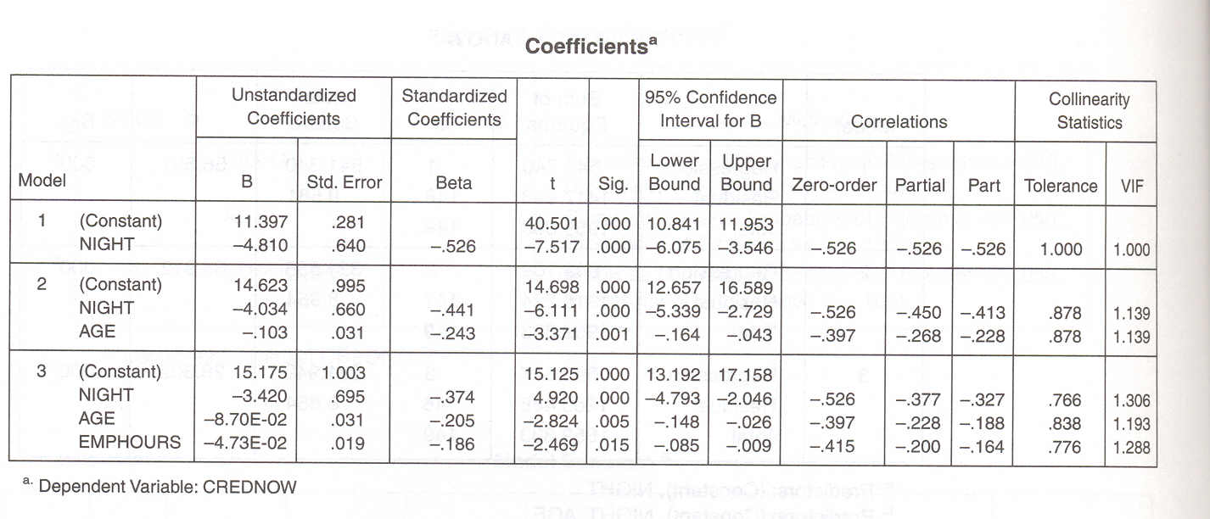
The Collinearity Problem
Great News!
The coefficients box in the SPSS output
shows two Collinearity Statistics:
Tolerance & VIF

Slide 29
The Collinearity Problem
Tolerance = 1 – overlap of this predictor with all predictors
Tolerance = 1 – r²_{all other predictors}
Tolerance Range = 0 to 1

Slide 30
The Collinearity Problem
We want tolerance to be near 1, indicating independent predictors.
(Independent “jurors”)
If tolerance is < .36, we may have a problem.
.36 = 1.0 - .8², and remember that .8 is a common r cut-off

Slide 31
The Collinearity Problem
Variance Inflation Factor = VIF
VIF = 1 / Tolerance
VIF Range = 1 to infinite

Slide 32
The Collinearity Problem
We want VIF to be near 1!
Computationally VIF is the number of times the variance
of the corresponding parameter
estimate is increased due to multicollinearity
as compared to what it would be if there were no multicollinearity.

Slide 33
The Collinearity Problem
Why is large VIF a problem?
Large variance due to multicollinearity results in
both a lessened probability of rejecting the null hypothesis
and wide confidence intervals.

Slide 34
The Collinearity Problem
Analogy:
Collinearity is the disease.
Large VIF is the symptom.
(we could make our VIF cut-off 1/.8² = 1/.36 = 2.77)

Slide 35
The Collinearity Problem
Practical Solutions to Collinearity Problem:
1. Average the inter-correlated variables together,
and use the newly averaged variable instead of its constituents.
or
2. Just remove one or more of the variables that are redundant.

Slide 36
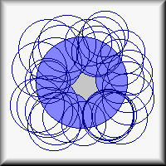
The Collinearity Problem
From the Web site of Dr. Alex Yu
When there are too many variables,
it is likely that Y is almost entirely covered by many inter-related Xs.
The variance explained is very high
but this model is over-specified and thus useless.

Slide 37
The Collinearity Problem
From the Web site of Dr. Alex Yu
“A student asked me what variables are related to school performance.
In other words, he wants to know how he could improve his grade.
I told him that my fifty-variable regression model could predict almost 100 percent of class performance.
So, I told him to do the following: study long hours, earn more money, marry a good wife,
buy a reliable car, watch less TV, browse more often on the Web, exercise more often,
attend church more often, pray more often, go to fewer movies, play fewer video games, cut your hair more often, drink more milk and coffee...etc.
Needless to say, this "overspecified" advice derived from a overspecified regression model with
collinear predictors and artificially inflated variance is totally useless.”

Slide 38
The Collinearity Problem
From the Web site of Dr. Alex Yu
In research it is not enough to have a high number if you don't know what it means.
With too many independent variables,
you don't know which variables were adequate predictors and which were noise.
A sharpshooter might fire twice and hit a target,
a poor shooter can use a machine gun to blow away a target with 100 bullets.
Both hit the target, but the sharpshooter knows why it happened.

Slide 39
A Final Thoughts on MR
Collinearity Relates To
“Error Bars”
Surrounding the Regression Line

